Slide 1
Applied A.I. Solutions Development Program
Applied Mathematical Concepts for Deep Learning
Term Project
Predict Calorie Expenditure
GROUP 7
Bikash Giri (101575097)
Chia-Wei Chang (101570243)
Diparshan Bhattarai (101494737)
Hsi-Teng Liu (101576074)
Gavriel Kirichenko (101119609)
Abdul-Rasaq Omisesan (101571156)
Callum Arul (101585383)
Friba Hussainyar (101591222)

Slide 2
Agenda
Introduction: Friba Hussainyar
Dataset Overview: Gavriel Kirichenko
Feature Engineering & Selection: Callum Arul
Model Implementation & Hyperparameter Tuning: Hsi-Teng Liu
Model Evaluation: ABdul-Rasaq Omisesan
Demo: Diparshan Bhattarai
Next Step: Chia-Wei Chang
Conclusion: Bikash Giri
Lessons to Learn

Slide 3
Introduction
Kaggle Competition
Link: Predict Calorie Expenditure | Kaggle
Our objective was to develop a DL model that accurately predicts calorie expenditure based on physiological and activity data.
The challenge was to predict how many calories a person burns during physical activity using features such as age, weight, gender, height and heart rate. Accurate calorie estimation can help people better manage their fitness, nutrition, and health goals.
For the prediction, we used a Multi-Layer Perceptron (MLP) built with TensorFlow/Keras. We fine-tuned it through several experiments and finally selected the best model using cross-validation. Our model achieved excellent results with an R² of 0.996 and a very low RMSLE of 0.063.

Slide 4
Dataset Overview
The dataset comprises anonymized workout session data, with each row representing a single session. The primary objective is to predict the number of calories burned during these sessions.
Key Features:
Numerical Variables: Age, Height, Weight, Duration, Heart_Rate, Body_Temp
Categorical Variables: Sex
Target Variable: Calories
Evaluation Metric:
The evaluation metric for this competition is Root Mean Squared Logarithmic Error (RMSLE), which penalizes underpredictions more than overpredictions and is suitable for targets that span a wide range.

Slide 5
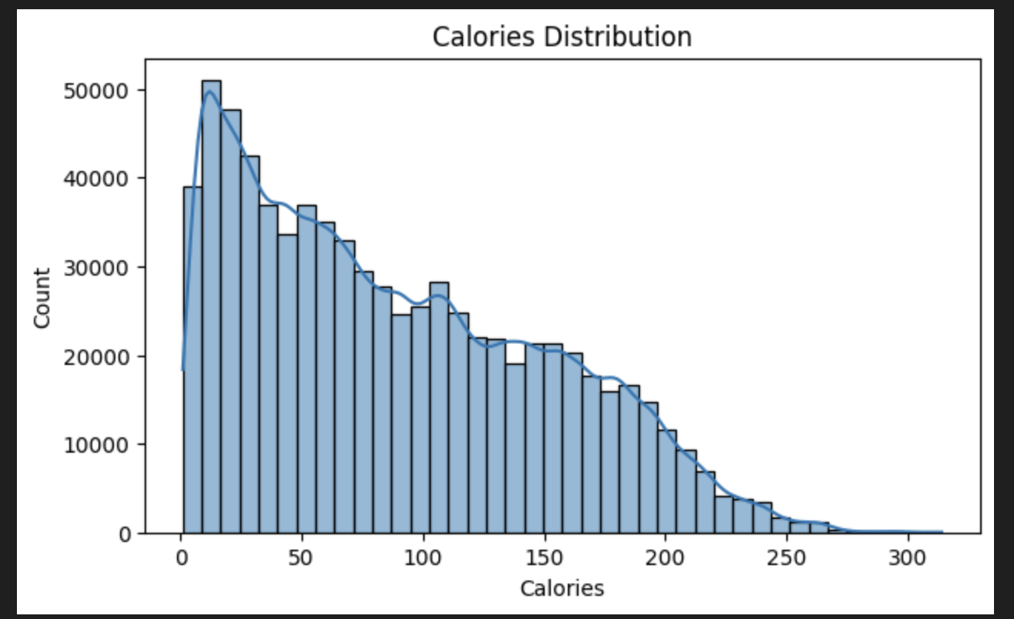
EDA - Calories Distribution

Slide 6
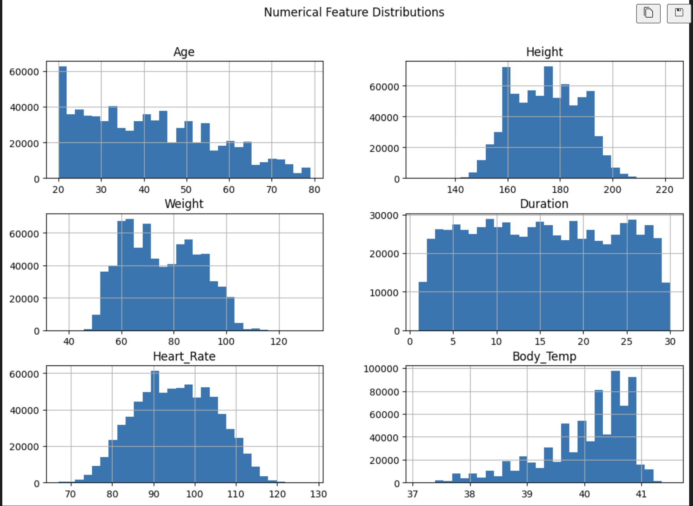
EDA - Numerical Feature Distributions

Slide 7
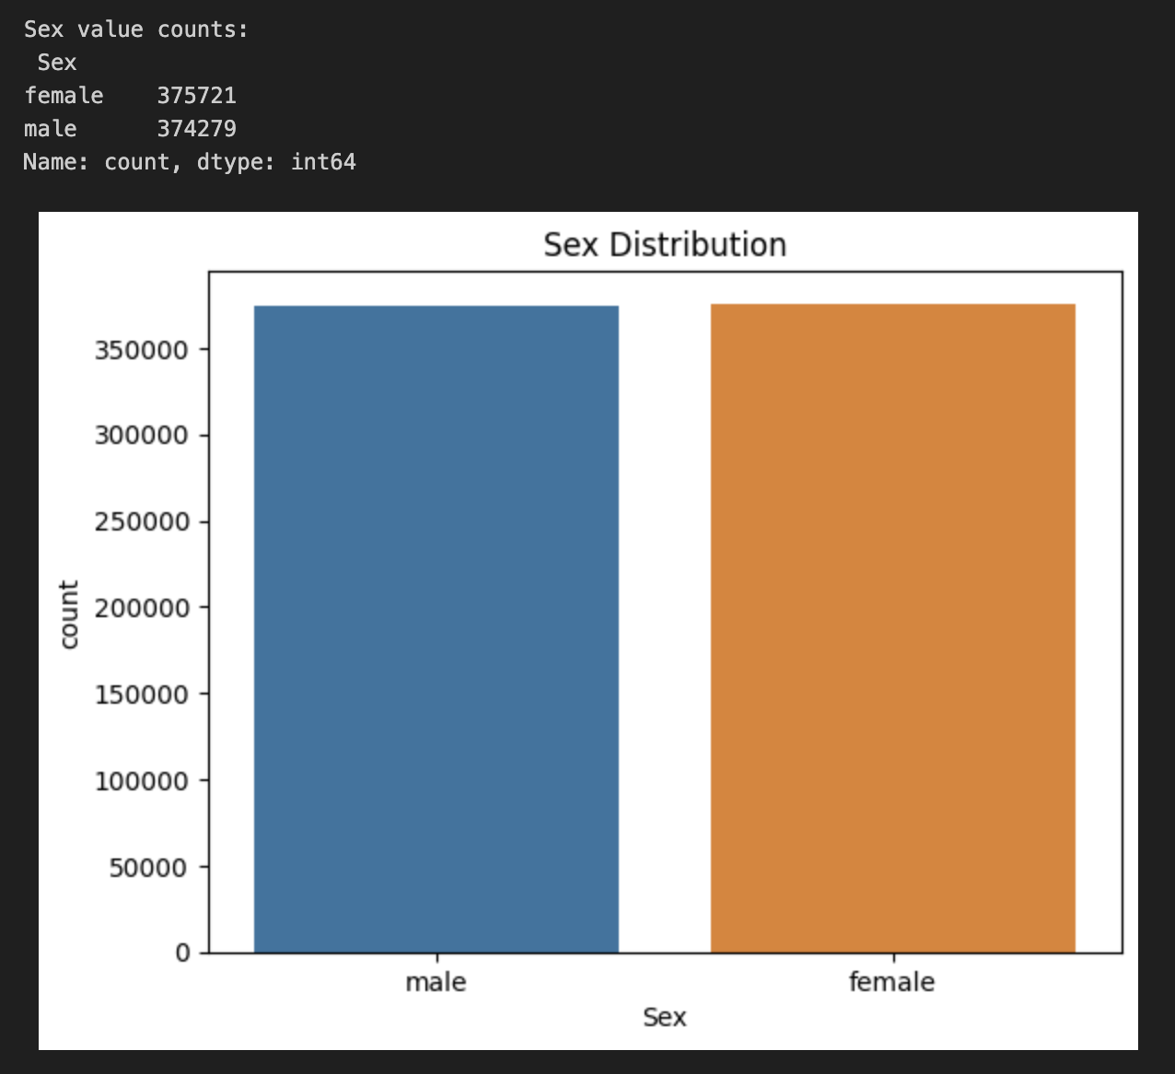
EDA - Sex Distribution

Slide 8
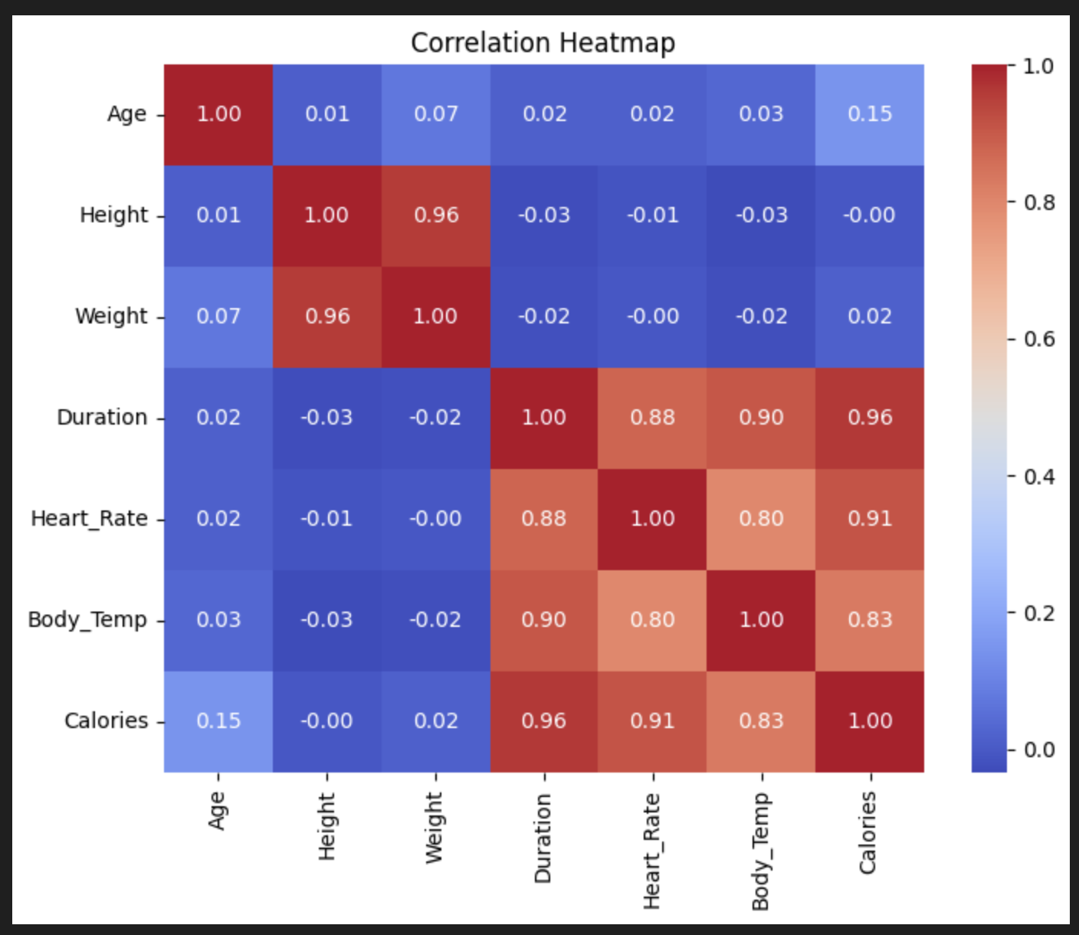
EDA - Correlation Heatmap

Slide 9
EDA - Missing Values
About 5% of height entries were missing - imputed using the median.
Outliers beyond 1.5×IQR were capped at the nearest whisker, affecting about 2% of records.

Slide 10
Feature Engineering & Selection
Code: Dense notebook5a7e8f4039
Added new features:
Cross Terms (e.g. Weight × HeartRate)
Interaction Features - Sum, difference, and ratio terms
Row-wise Stats (mean, std, max, etc.)
Feature Selection:
Dropped features with correlation > 0.95 (reduces redundancy)
Selected Top 100 via LightGBM feature importance
Visualized Top 20 to gain insights into key predictors

Slide 11
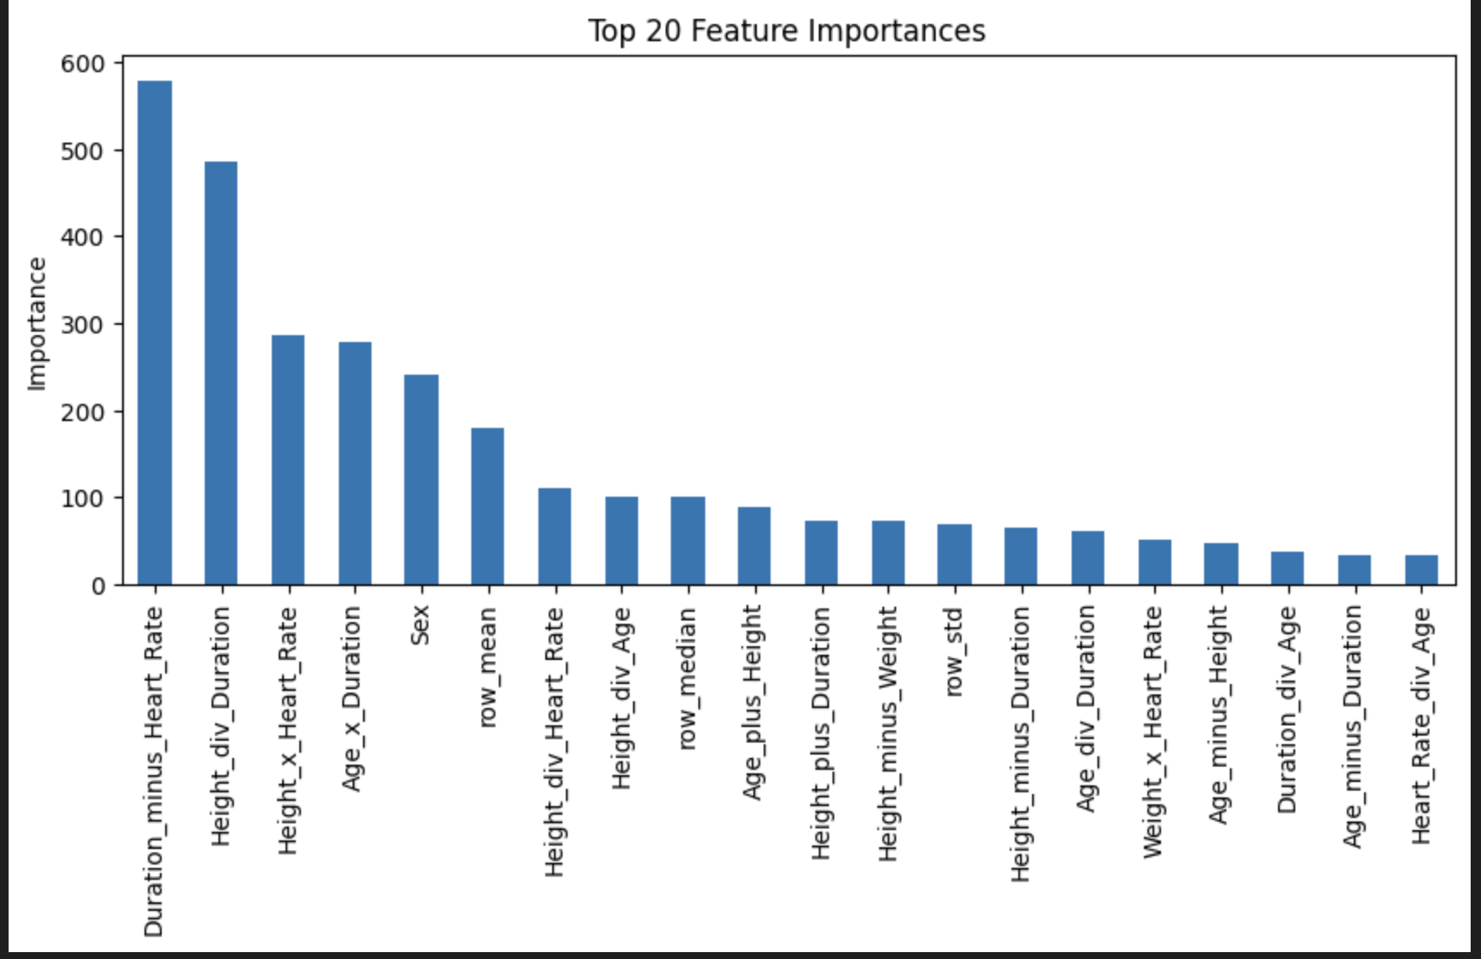
Feature Engineering & Selection

Slide 12
Model Implementation & Hyperparameter Tuning
First Attempt: A Simple Approach with MinMaxScaler
Layer 1: 6 nodes with tanh activation
Layer 2: 4 nodes with ReLU activation
Learning Rate: 0.001
RMSLE = 0.06064

Slide 13

Model Implementation & Hyperparameter Tuning
Second Try with Help from Optuna
Layer 1: 555 nodes with tanh activation, Batch Normalization, Dropout of 0.277
Layer 2: 277 nodes with ReLU activation, Batch Normalization, Dropout of 0.277
Learning Rate: 0.0001277
RMSLE = 0.05947

Slide 14
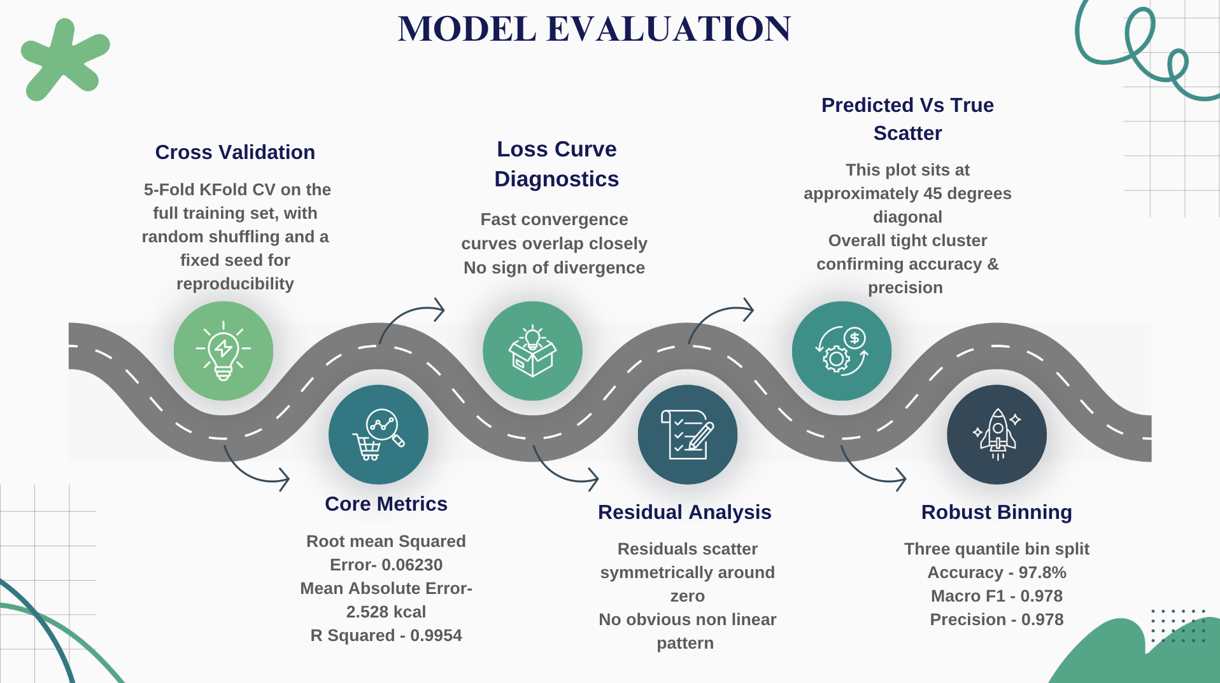

Slide 15
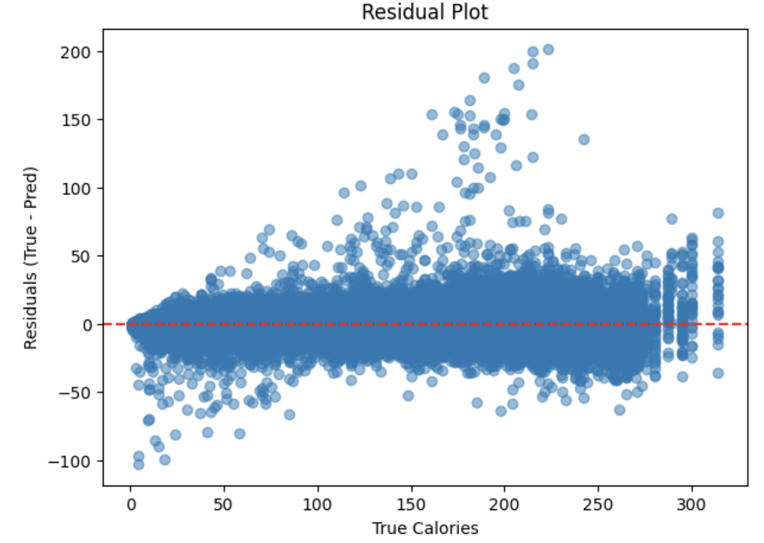
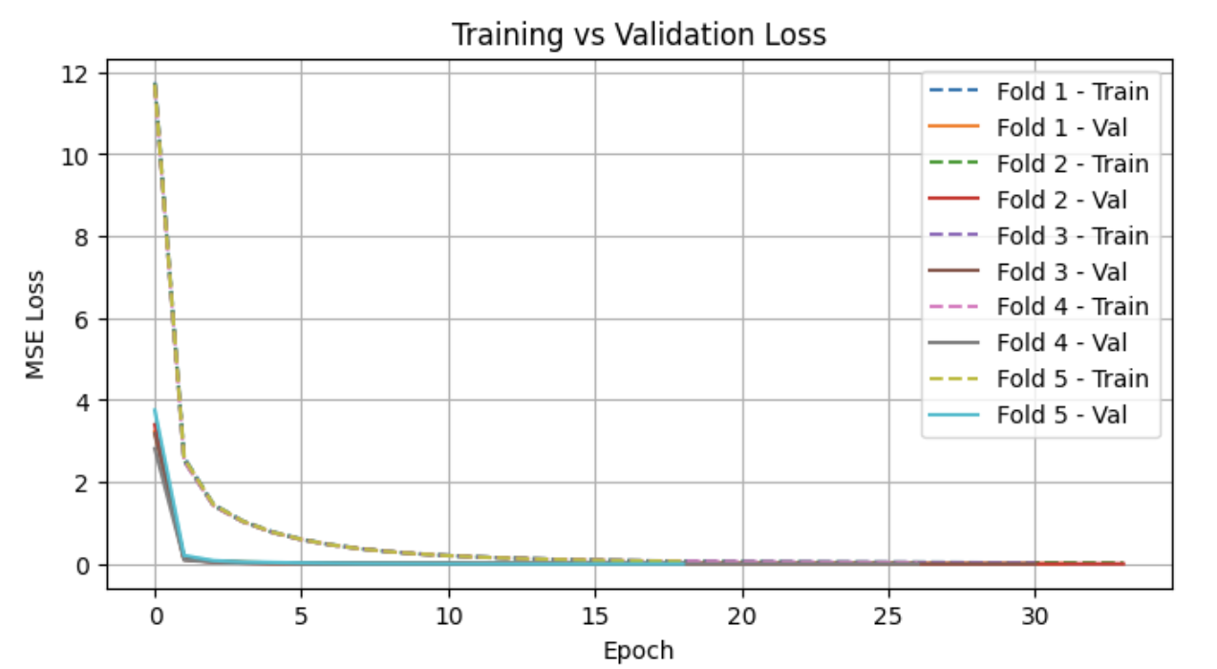
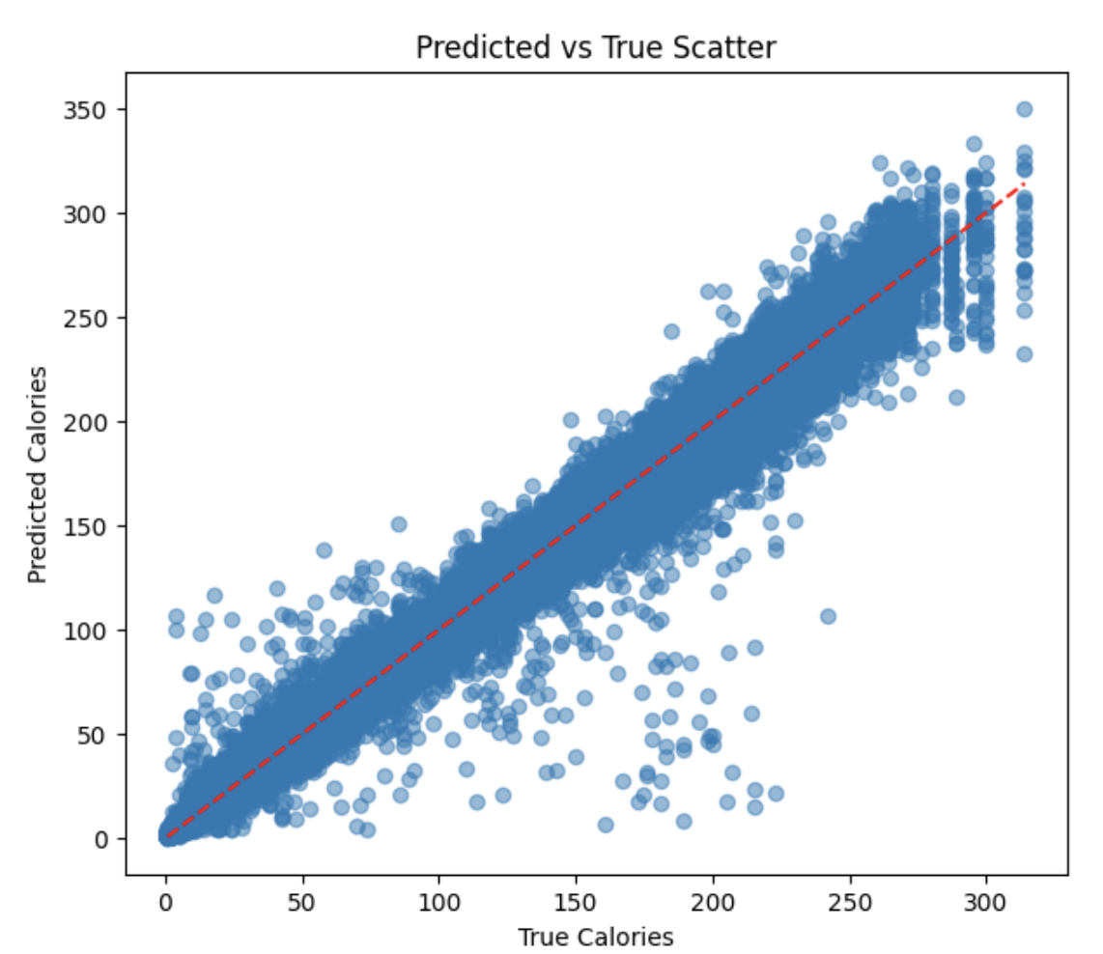
Model Evaluation Contd

Slide 16
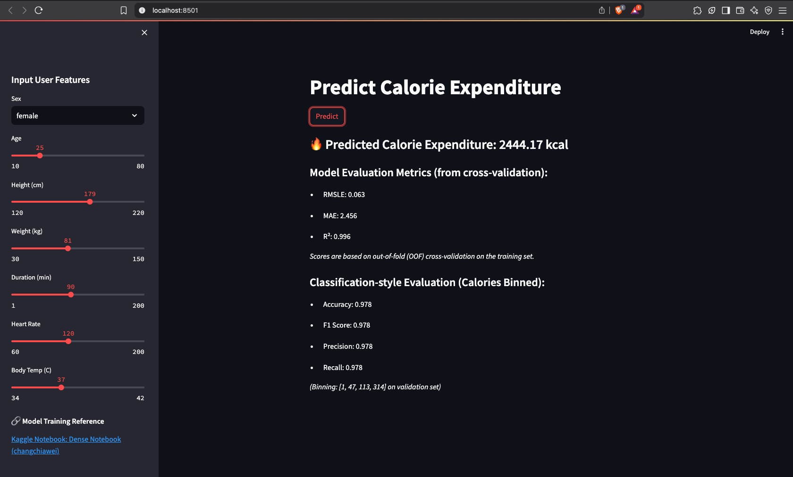
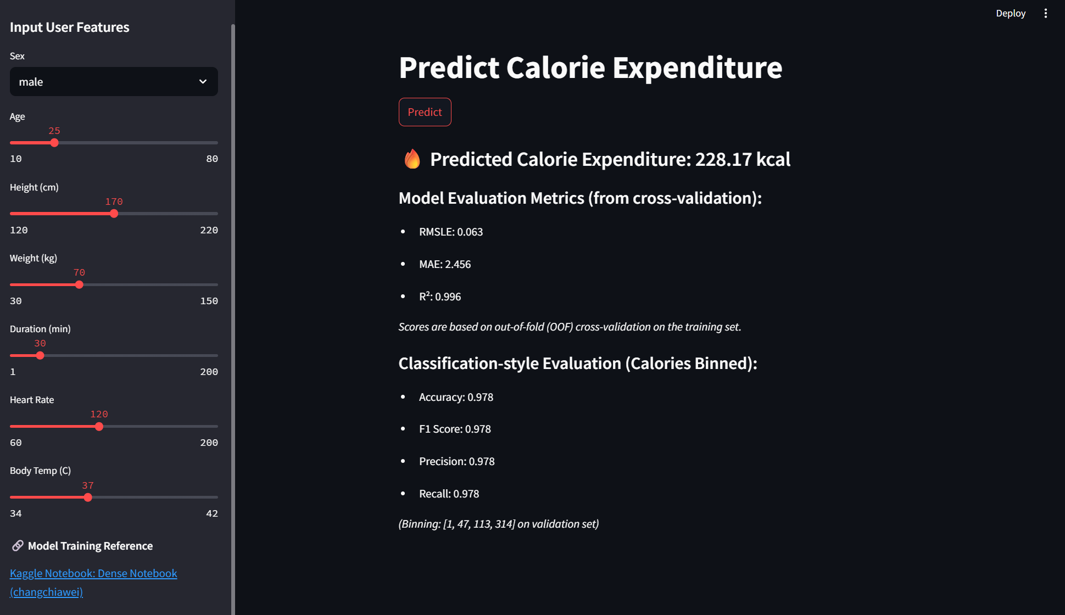
Demo
Code: link1

Slide 17
Next Step
What we did
How to Improving Competition Score:
Level 1: Advanced Modeling Strategy: Model Stacking
To achieve a higher score in the competition, we need to go beyond using a single model.
Currently, we're relying on one model, but we can improve performance through model stacking combining multiple models such as CatBoost, XGBoost, and LightGBM.
By applying ensemble techniques like voting or blending, we can make our predictions more accurate, stable, and competitive.
Level 2: Stacking Public Submissions for Higher Scores
As we observed from other teams in the competition, some teams achieved higher scores by stacking public submission data from other Kaggle notebook.
By identifying groups with higher leaderboard scores, we can:
Collect 10+ strong public submissions
Ensemble their predictions using techniques like median voting
Improve the robustness and accuracy of our final prediction
1. Feature Engineering
Added cross-product features (e.g., Age × Height).
Created interaction features (sum, difference, division).
Generated row-level statistics (mean, std, max, etc.).
2. Feature Selection
Removed highly correlated features (correlation > 0.95).
Used LightGBM to select top 100 important features.
3. Data Preprocessing
Standardized numerical features using StandardScaler.
4. Model Optimization with Optuna
Defined objective function for hyperparameter tuning of MLP (hidden size, dropout, learning rate).
Used 5-fold cross-validation to evaluate performance.
Selected best hyperparameters after 20 trials.
5. Model Training & Prediction
Trained final MLP model with best parameters using 5-fold CV.
Saved model and preprocessing artifacts (scaler, top features).
Generated test predictions by averaging across folds.

Slide 18
Conclusion

Slide 19
Lessons to Learn
Bikash Giri (101575097)
Chia-Wei Chang (101570243) - I learned how to train a dense deep learning model using Optuna to find the optimal hyperparameters, including the number of nodes
Diparshan Bhattarai (101494737) - I learned how to prepare data for modeling by removing redundant features, selecting the most important ones using LightGBM, and standardizing inputs to improve model performance and accuracy.
Hsi-Teng Liu (101576074) - Sometimes it’s worth considering a simpler mode which has slightly worse performance, but needs significant less resources when training and inferencing.
Gavriel Kirichenko (101119609) - I learned that deep learning isn’t always the best solution in fact, in our case, smaller models like XGBoost performed better.
Abdul-Rasaq Omisesan (101571156) - I learned that thoughtful feature engineering and 5-fold cross-validation can beat simply building bigger networks.
Callum Arul (101585383) - I learned that you can dramatically improve model performance not just by tuning models, but by engineering smart features
Friba Hussainyar (101591222) - I learned how to use the streamlit and connect the model to the front-end.

